Slide 1
GIT MINI PROJECT
V SHRIVATHSAN
18MER191

Slide 2
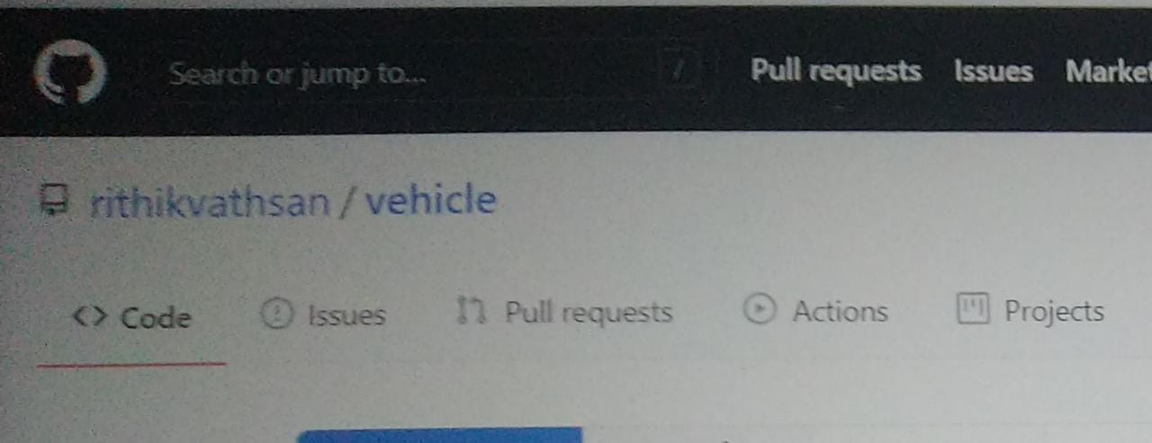
CREATING VEHICLE REPOSITORY

Slide 3
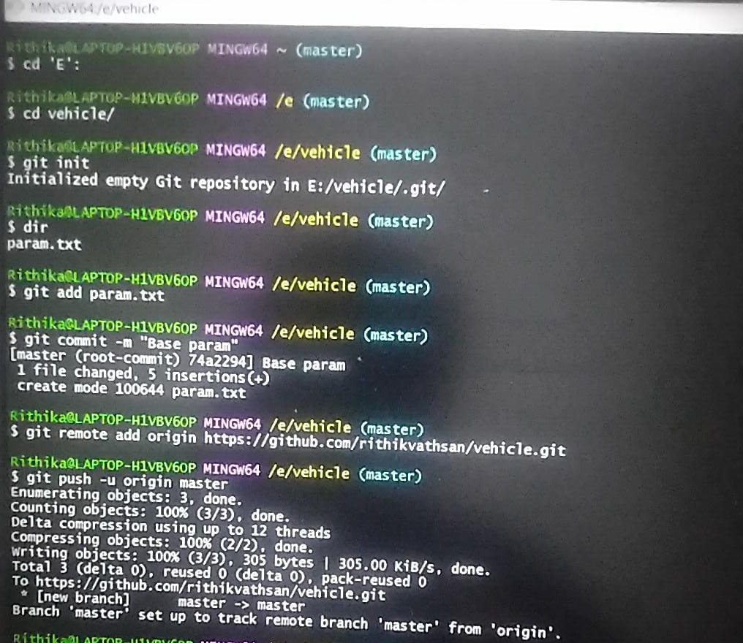
ADD A FILE IN MASTER AND NAME AS BASE PARAM

Slide 4
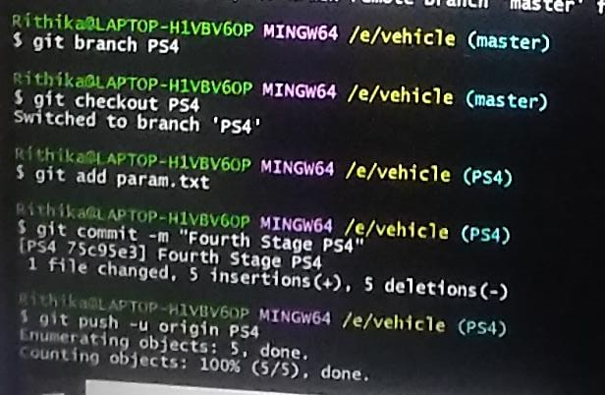
CREATE A NEW BRANCH AS PS4

Slide 5
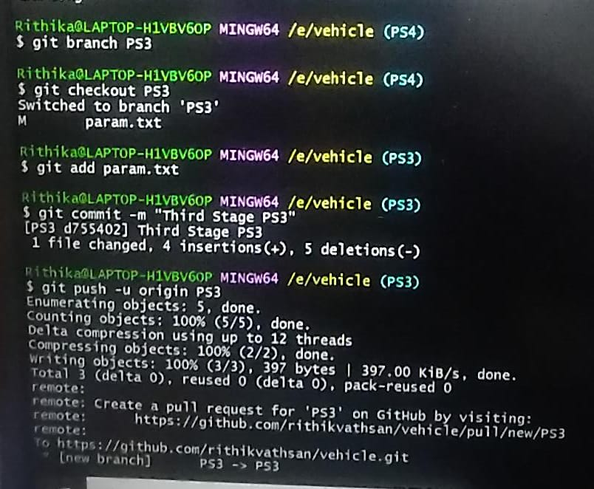
CREATING A NEW BRANCH AS PS3

Slide 6
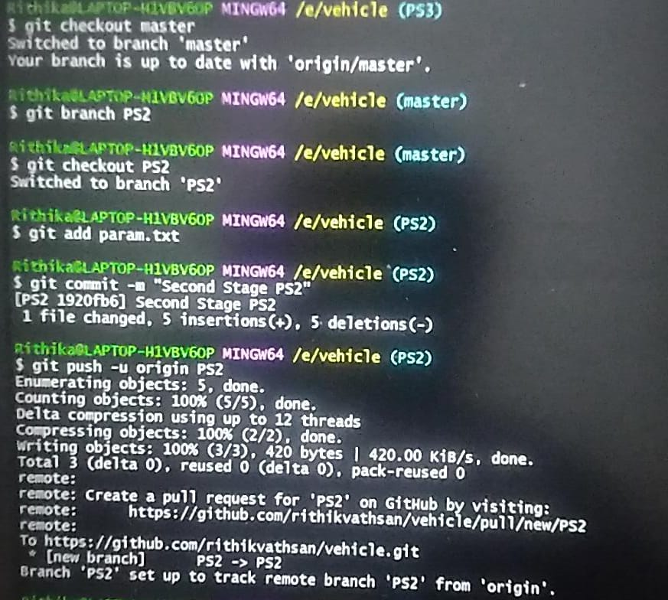
CREATING A NEW BRANCH AS PS2

Slide 7
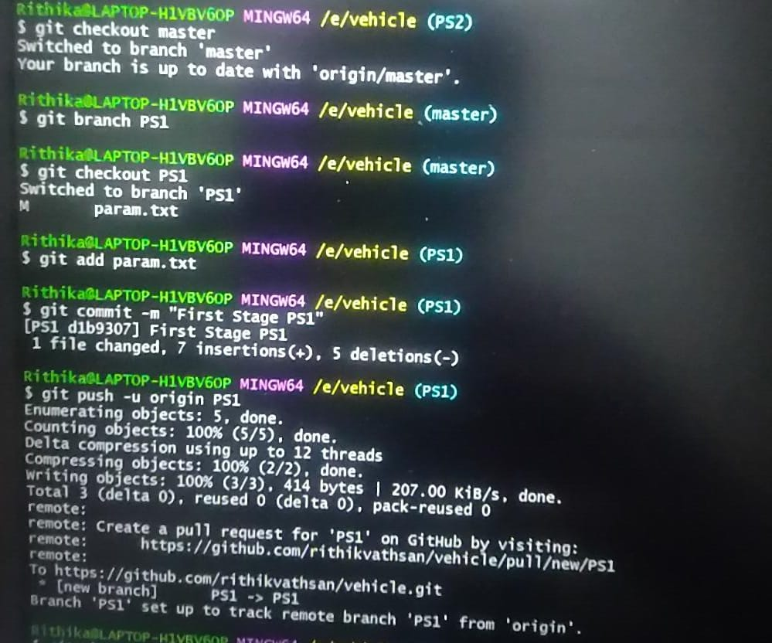
CREATING A NEW BRANCH AS PS1

Slide 8
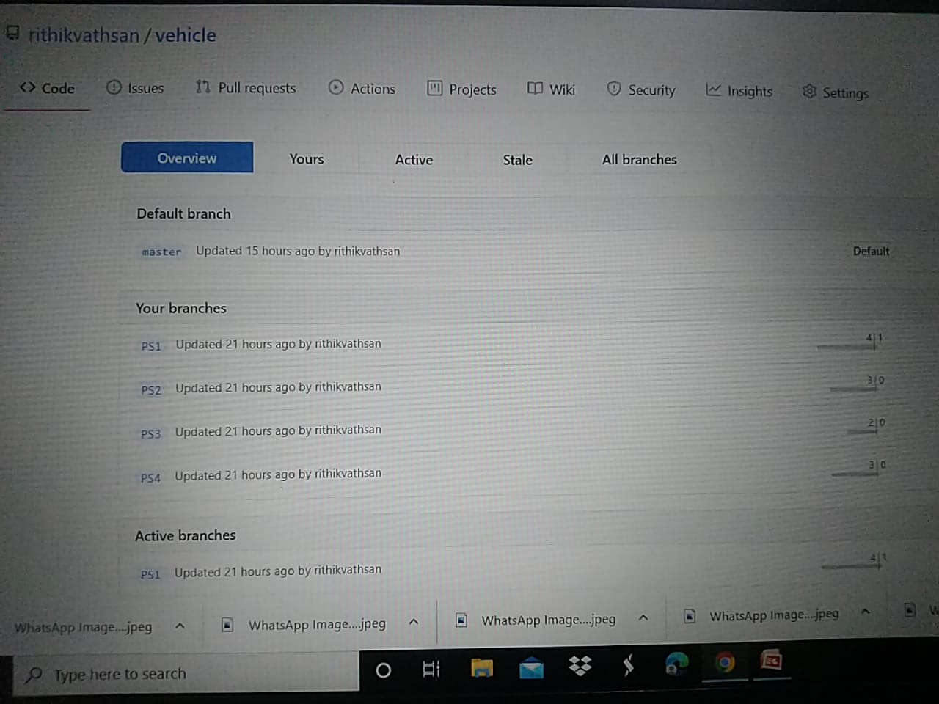
CREATED FOUR BRANCHES

Slide 9
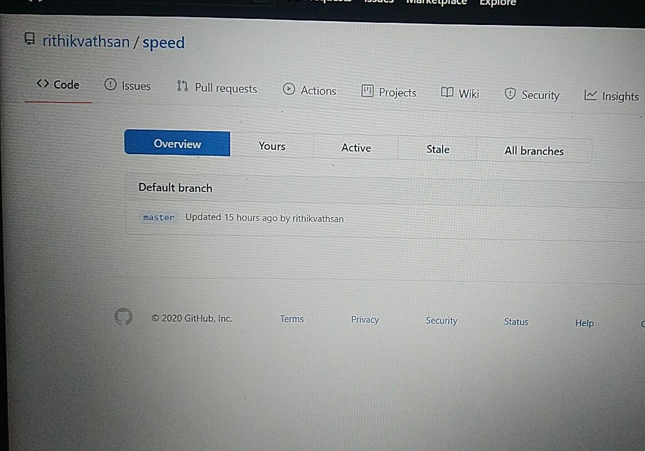
CREATEING SPEED REPOSITORITY

Slide 10
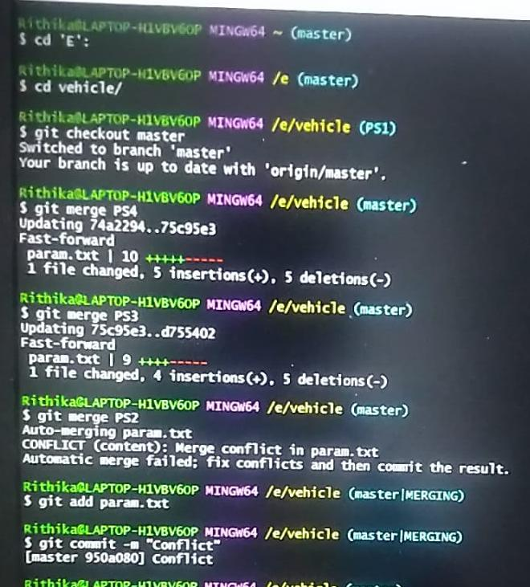
MERGING THE BRANCHES

Slide 11
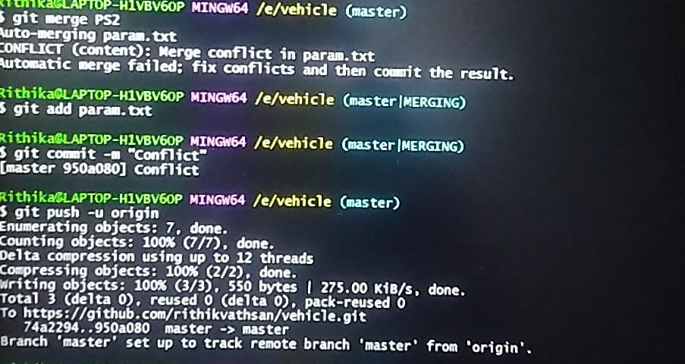
MERGE CONFLICT

Slide 12
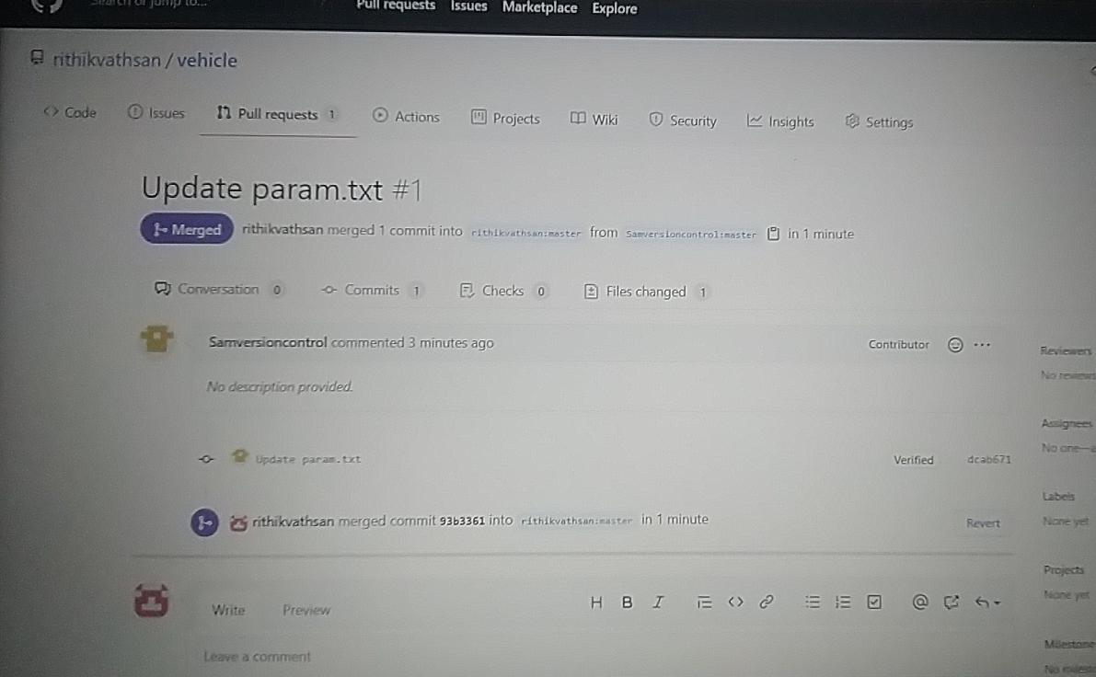
MERGING PULL REQUEST

Slide 13
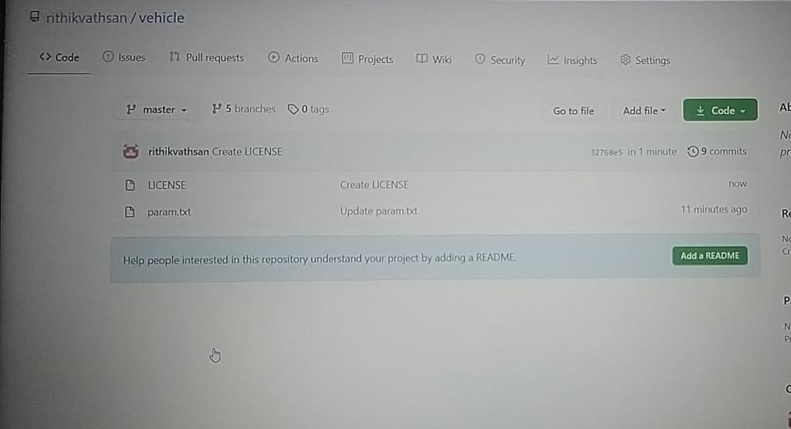
MIT LICENSE

Slide 14
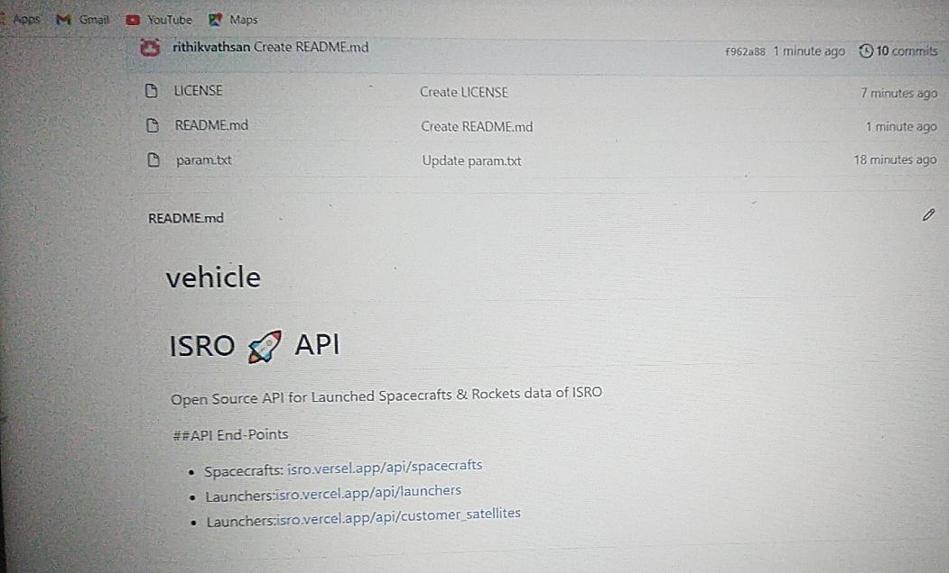
CREATING A README FILE

Slide 15
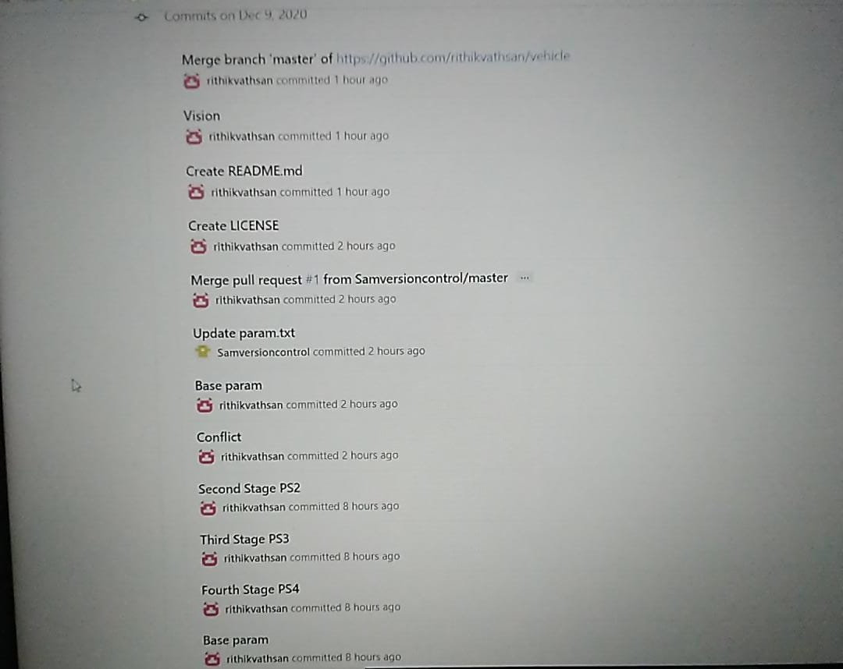
GRAPHICAL VIEW OF COMMIT

Slide 16
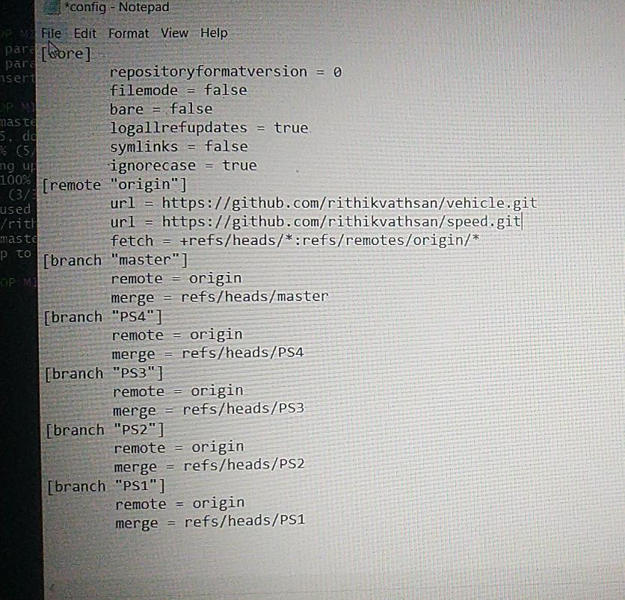
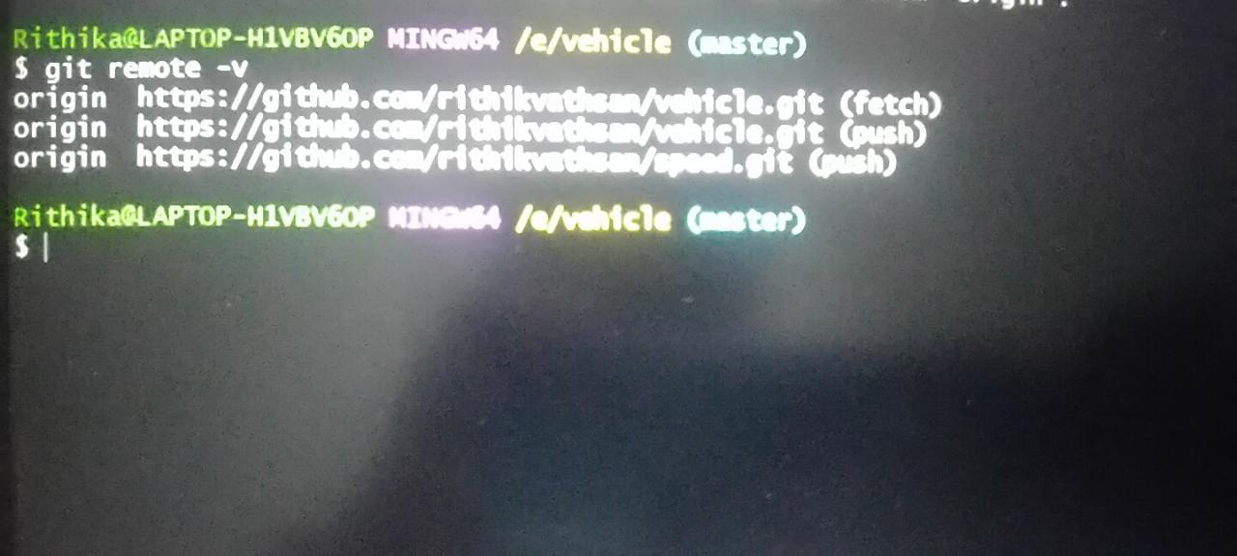
CREATE VISION.TXT FILE AND ADD IT ON BOTH REPOSITIORY

Slide 17
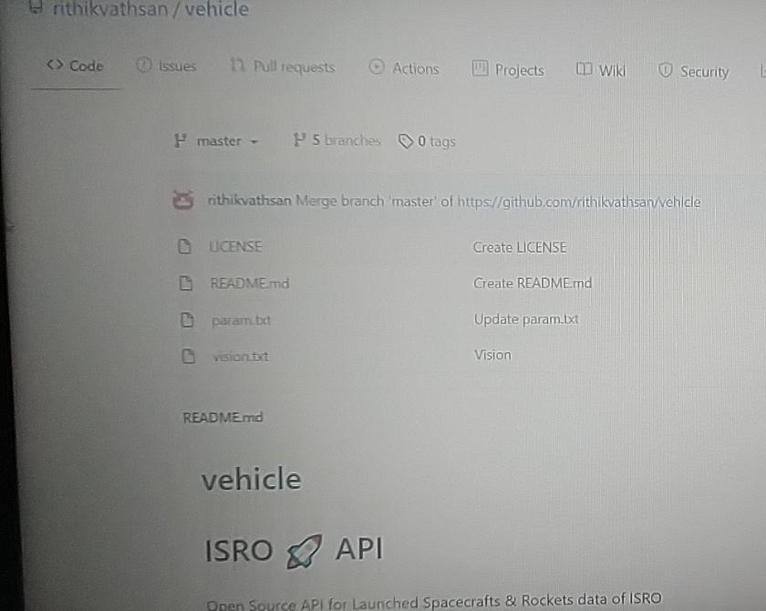
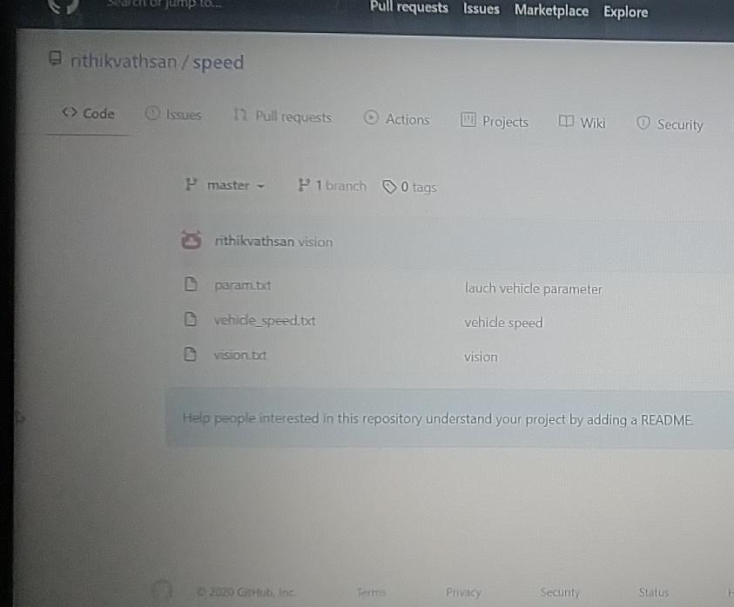
BOTH REPOSITIORY VISION FILE ADDED

Slide 18
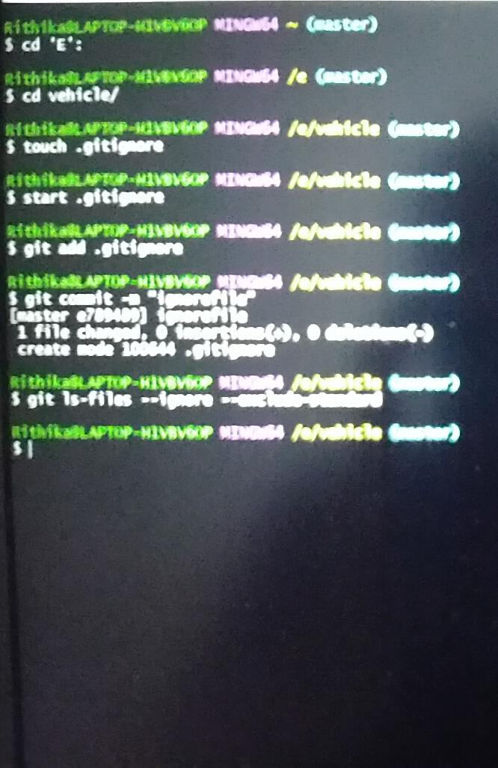
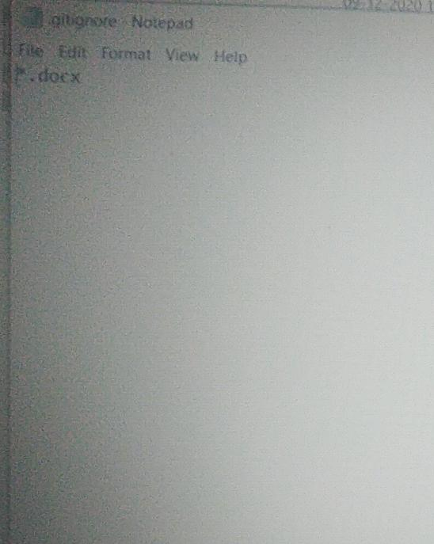
ADDING GIT IGNORE FILE

Slide 19
THANK YOU

